Slide 1
19CSE211
MIPS Pipeline Data Hazard
Term2 Session3
Forwarding Logic design
02-03-2021

Slide 2
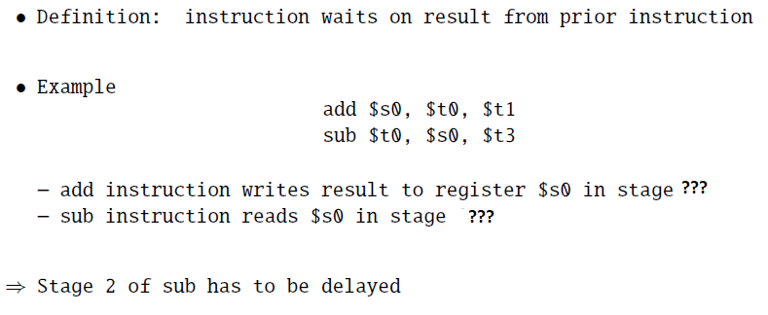
Data Hazard

Slide 3
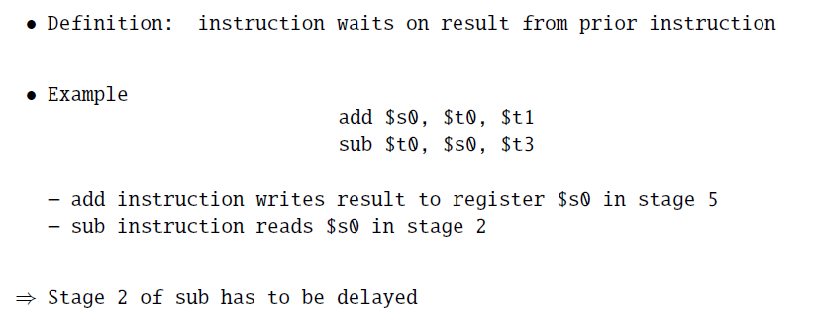
Data Hazard

Slide 4
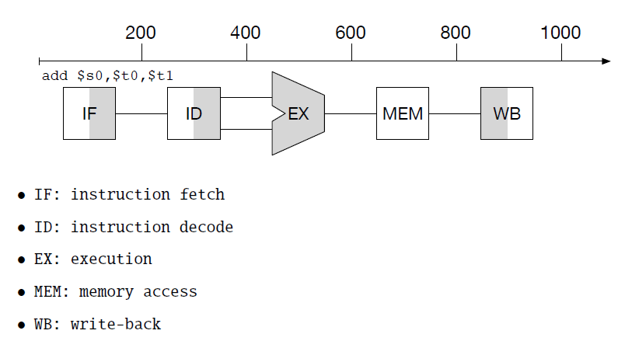
Graphical Representation

Slide 5
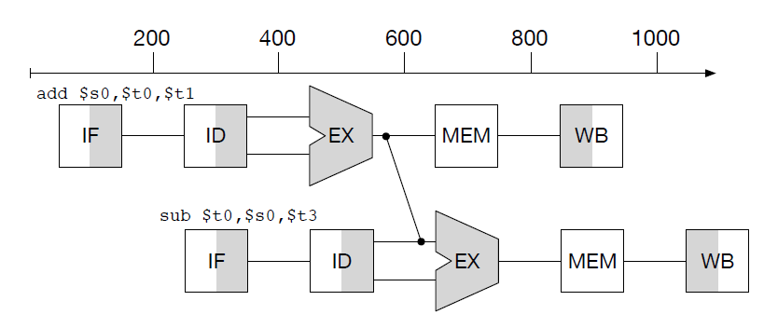
Add and Subtract
Add wiring to circuit to directly connect output of ALU for next instruction

Slide 6
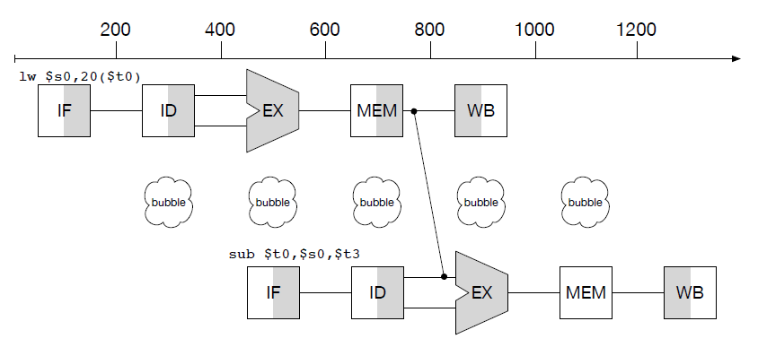
Load and Subtract
Add wiring from memory lookup to ALU
Still 1 cycle unused: "pipeline stall" or "bubble"

Slide 7
Forwarding

Slide 8
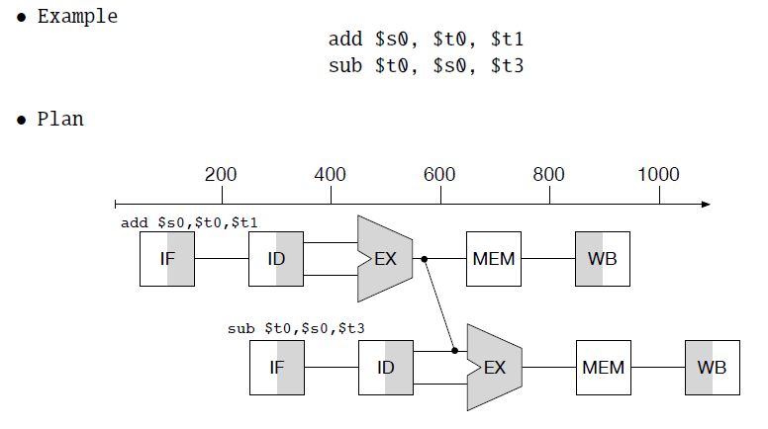
Add and Subtract

Slide 9
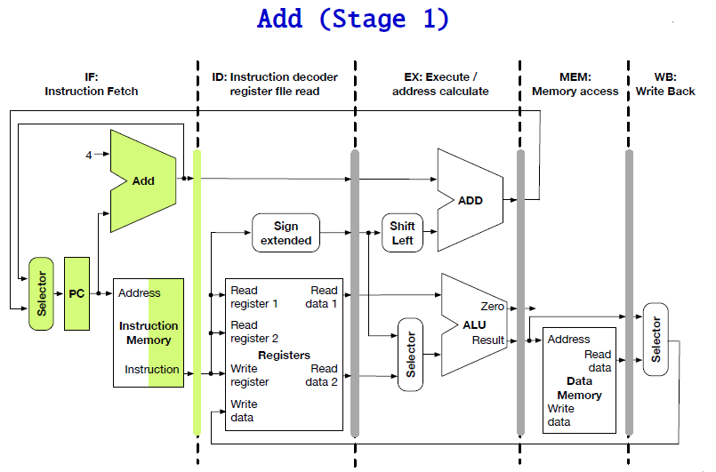

Slide 10
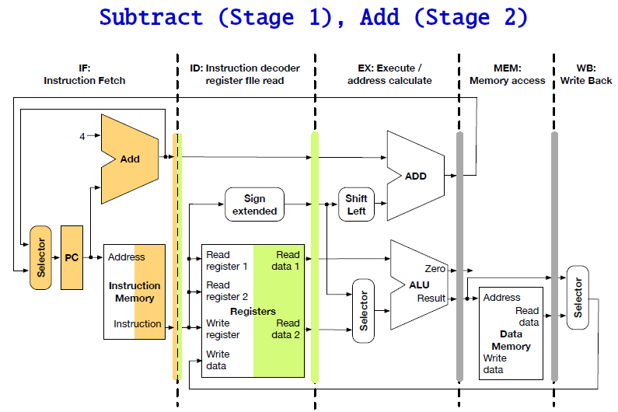

Slide 11
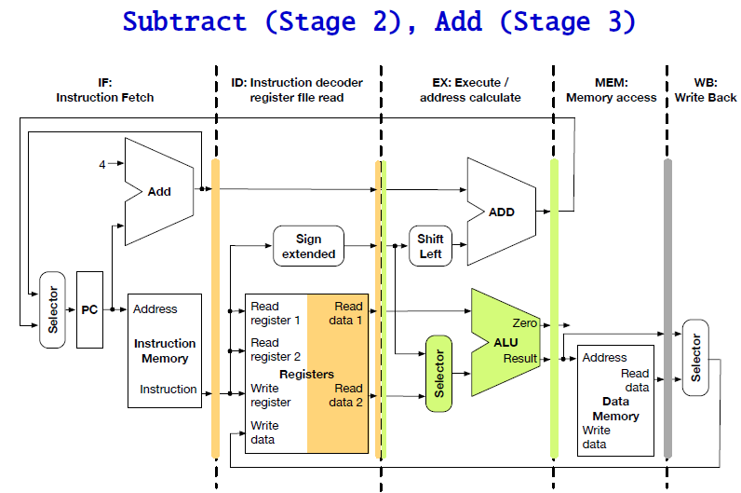

Slide 12
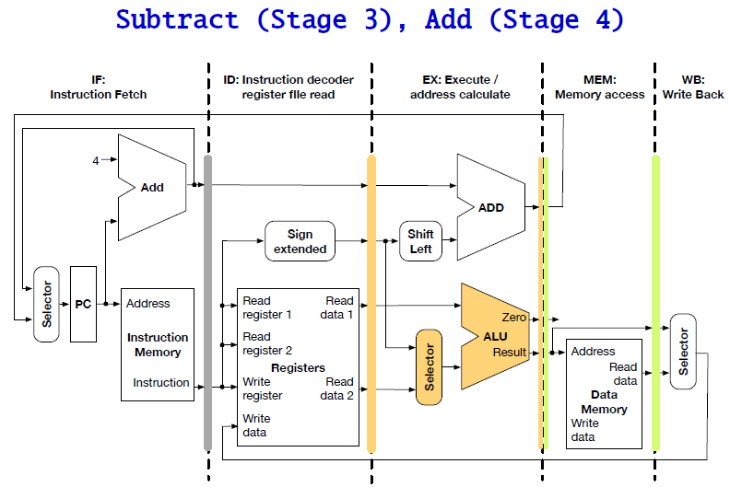

Slide 13
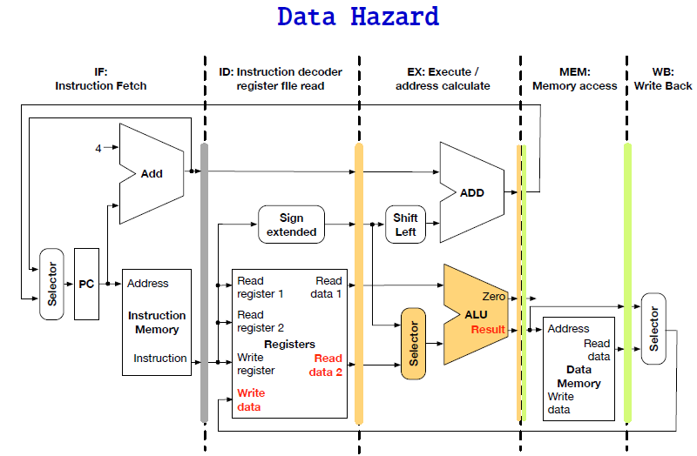

Slide 14
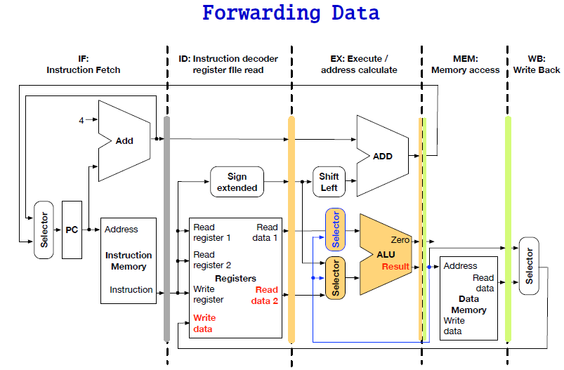

Slide 15
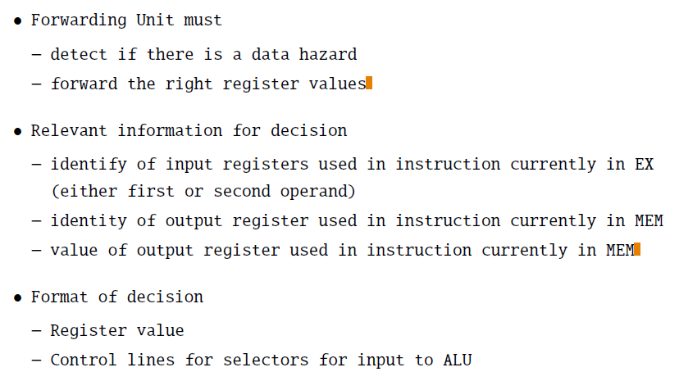
Forwarding Unit

Slide 16
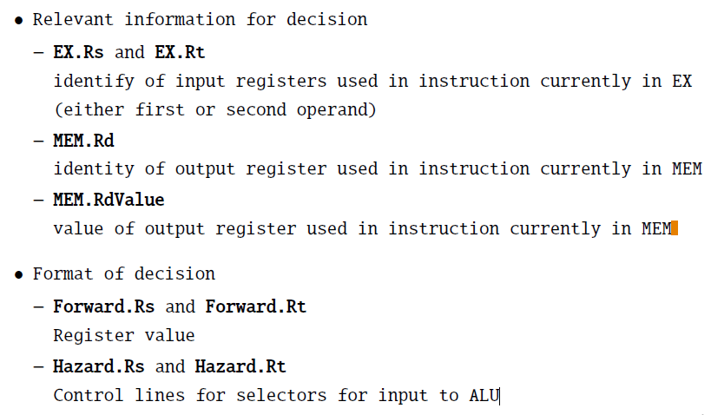
Formal Names

Slide 17
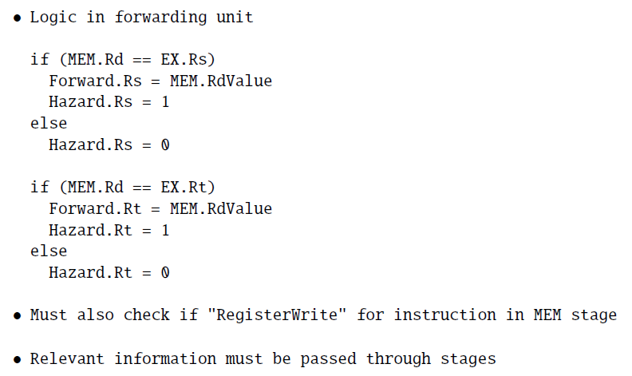
Forwarding Logic

Slide 18
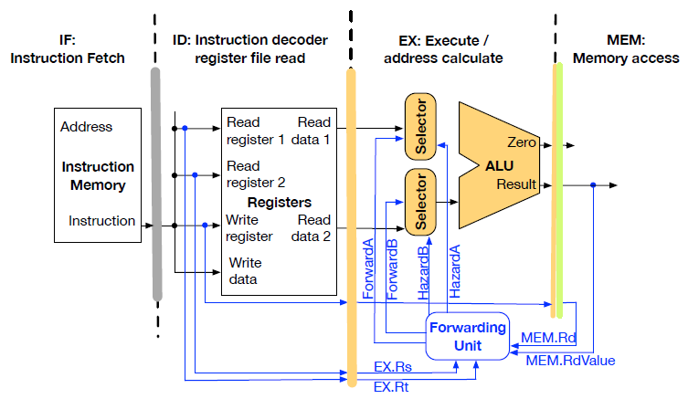
Forwarding Unit

Slide 19
Identify the Hazard and reorder the code
lw $t1, 0($t0)
lw $t2, 4($t0)
add $t3, $t1, $t2
sw $t3, 12($t0)
lw $t4, 8($t0)
add $t5, $t1, $t4
sw $t5, 16($t0)

Slide 20
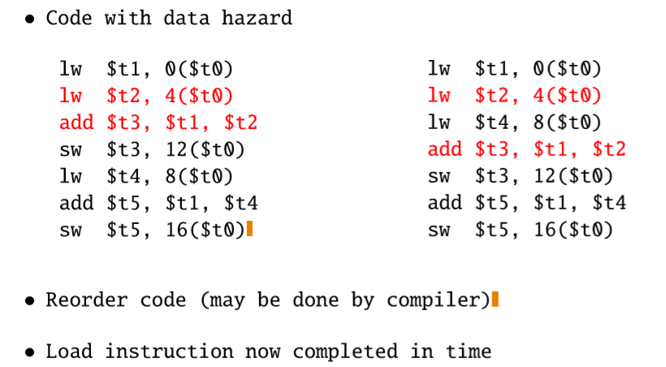

Slide 21
Reference and Courtesy: http://www.cs.jhu.edu/~phi/csf/ http://www.cs.jhu.edu/~phi/csf/slides/lecture-mips-pipelining.pdf http://www.cs.jhu.edu/~phi/csf/slides/lecture-mips-hazards.pdf

